Slide 1
Advancing Engineering Design Guidance for Constructed Salt Marshes with High Fidelity Modeling and Long-Term Monitoring
Project Number: NH24-8072
Principal Investigator: Todd Steissberg
PI’s Organization: Environmental Laboratory, U.S. Army Engineer Research and Development Center
In Progress Review Meeting
June 10, 2025

Slide 2
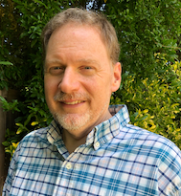
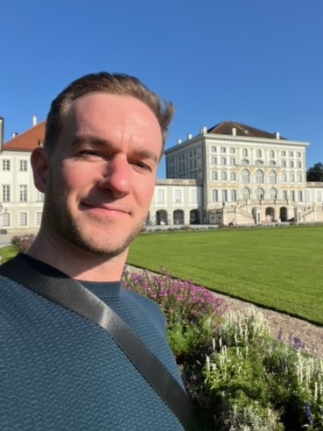

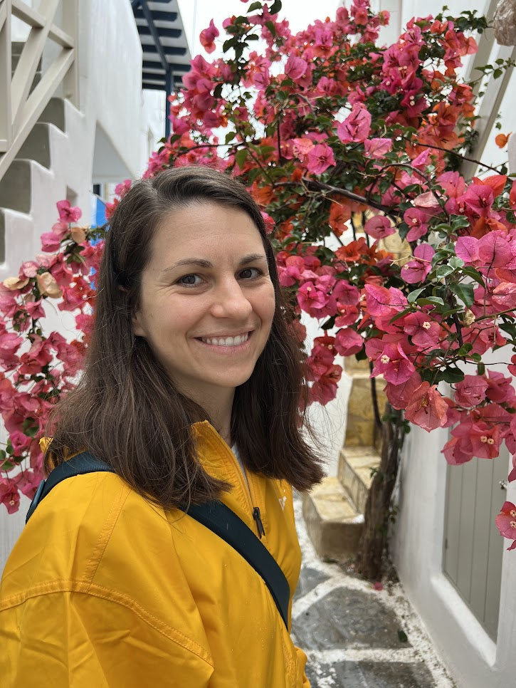
Project Team
Todd Steissberg, Lead PI
Environmental Laboratory US Army Research and Development Center
Co-Performers and Host Military Installation POCs:
Scott Mauro, NAVFAC Engineering & Expeditionary Warfare Center
Mark Patterson, NAVFAC Engineering & Expeditionary Warfare Center
Collaborators:
Deltares
San Francisco Environmental Institute (SFEI)
Matt Smith, Co-PI
Institute for Water US Army Corps of Engineers
Marriah Abellera, Co-PI
Institute for Water US Army Corps of Engineers
Jenny Olszewski, Co-PI
USGS
Notes:
Don’t spend too much time presenting this slide.

Slide 3
Bottom Line Up Front
What technology or methodology is being evaluated during this demonstration?
A fully integrated modeling framework linking hydrodynamics, waves, vegetation (NBSDynamics), and sediment processes (SEMIDEC) to evaluate and optimize salt marsh restoration design.
What's been going well?
Successfully completed Phase I (site selection, data collection, model development, and identification of key calibration parameters for the fully integrated hydrodynamic, wave, and vegetation model)
Initiated Phase II and making steady progress toward completing calibration and validation of the model
Strong support from partners (Deltares, SFEI, Navy) in data collection, subject matter consultation, and the identification/selection of a second marsh case study site

Slide 4
Bottom Line Up Front (continued)
What's not working?
Internal administrative delays and staff turnover have delayed contract award and initial progress.
Vegetation and sediment model components not yet fully integrated and calibrated
Despite these issues, the team is poised to accelerate model validation and simulation efforts in the next quarter and realign with the overall project timeline.
What support do you need?
Continued coordination with Deltares to integrate and calibrate vegetation and sediment models
Timely resolution of internal staffing and contracting to maintain project momentum

Slide 5
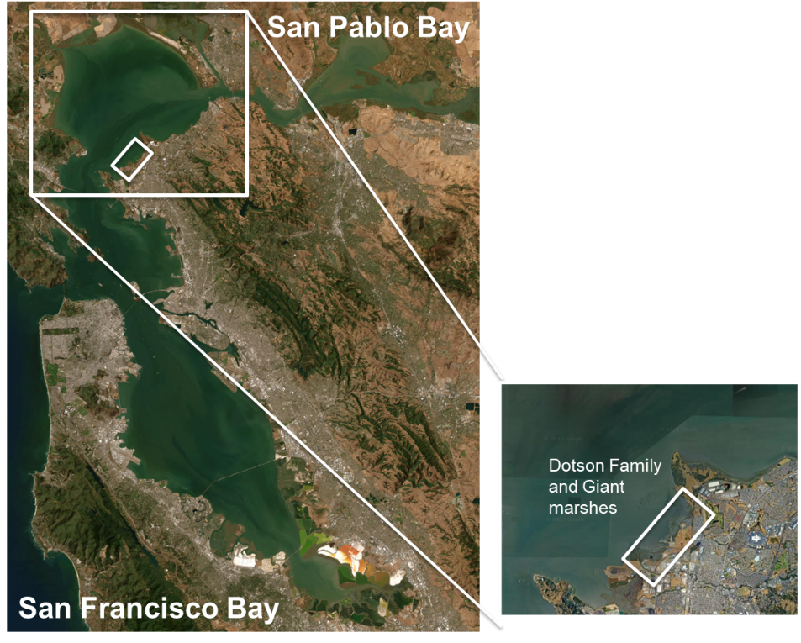
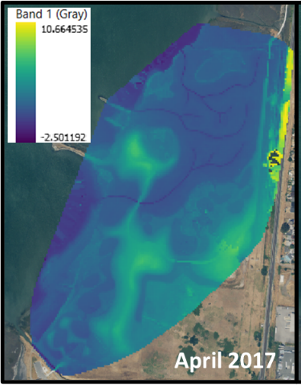
Site Description
Dotson Family Marsh, San Pablo Bay, CA
30-acre tidal marsh habitat with a mix of high and low marsh habitat and mudflats.
The site was partially restored in 2015-2016. This restoration focused on removing fill soil and adding tidal channels to re-establish the natural marsh plain.
This marsh sits adjacent to an unrestored (natural) benchmark site – Giant Marsh.
Low wave energy environment that has demonstrated successful vegetation establishment and growth since 2017.

Slide 6
Technical Approach and Test Design
Technical Objectives
Validate and calibrate the developed salt marsh model for one selected benchmark (natural) or reference (long-term restoration) and one more recent restoration site.
Evaluate wave attenuation and habitat performance at paired sites under historic conditions.
Evaluate wave attenuation and habitat performance at paired sites under a range of potential future sea level rise scenarios.
Use lessons learned to develop initial recommendations for a framework linking modeling, field and lab research, monitoring, and design evolution.
Notes:
This section should encompass several slides. Liberal use of schematic diagrams, tables, and figures is encouraged.
Provide a description of the system design and testing to be conducted to address the performance objectives. Include issues such as:
Conceptual experimental design
Baseline characterization activities
Design and layout of technology components
Field testing
Sampling plan
Describe how the project will measure the baseline/current approach to the problem compared to the new technology/methodology
Examples: side-by-side, baseline/intervention or sequential testing
Consider: What changes?, What key measurements depict change?
Briefly describe the technical objective(s) of the demonstration project

Slide 7
Technical Approach and Test Design (Technical Approach Example diagram on next slide)
Technology: This effort proposes two contributions to the existing salt marsh modeling field
To develop a spatially distributed model that builds on existing models to strengthen the feedback loops existing between hydrodynamics, morphology, and vegetation lifecycle processes; and
To use that model to develop a framework for salt marsh design for specific performance objectives.
Notes:
This section should encompass several slides. Liberal use of schematic diagrams, tables, and figures is encouraged.
Provide a description of the system design and testing to be conducted to address the performance objectives. Include issues such as:
Conceptual experimental design
Baseline characterization activities
Design and layout of technology components
Field testing
Sampling plan
Describe how the project will measure the baseline/current approach to the problem compared to the new technology/methodology
Examples: side-by-side, baseline/intervention or sequential testing
Consider: What changes?, What key measurements depict change?
Briefly describe the technical objective(s) of the demonstration project

Slide 8
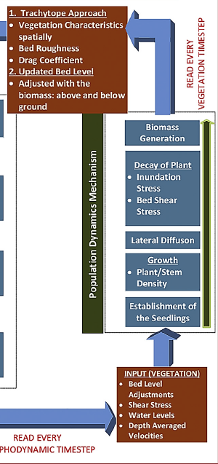
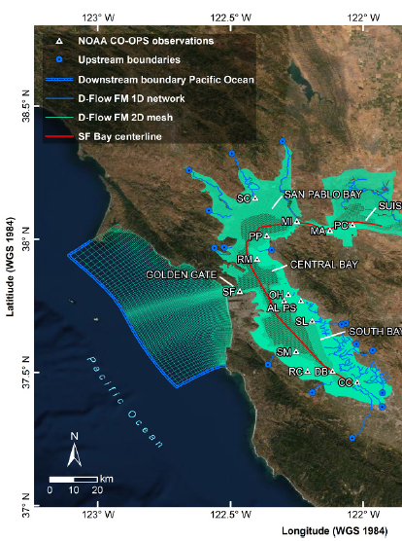
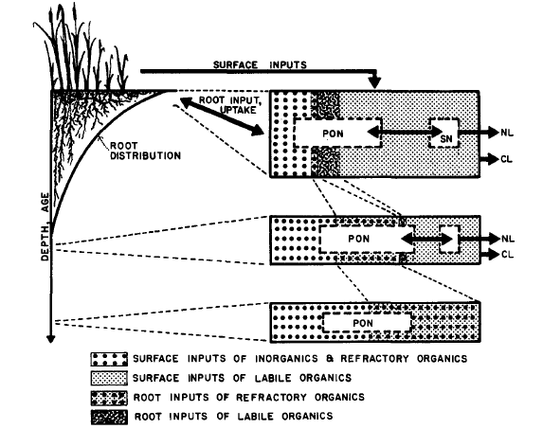
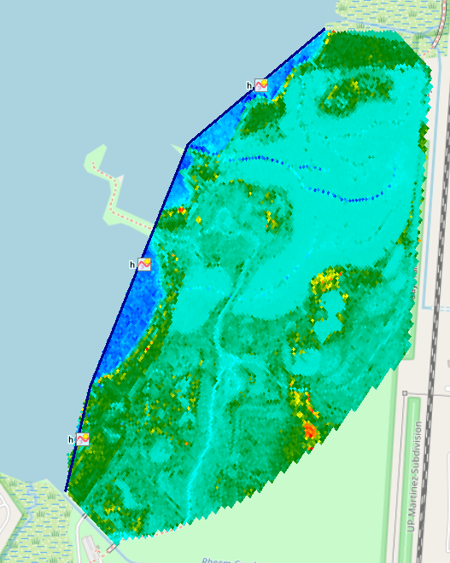
Technical Approach and Test Design (Technical Approach Example diagram on next slide)
We are currently linking the existing NBSDynamics (vegetation) model and coding up the SEMIDEC (sediment) models to the hydrodynamic and wave model developed for Dotson Family Marsh (nested within the larger SF Bay model developed by Nederhoff et al. (2021))
NBSDynamics model diagram developed by Best et al. (2018)
8
Notes:
This section should encompass several slides. Liberal use of schematic diagrams, tables, and figures is encouraged.
Provide a description of the system design and testing to be conducted to address the performance objectives. Include issues such as:
Conceptual experimental design
Baseline characterization activities
Design and layout of technology components
Field testing
Sampling plan
Describe how the project will measure the baseline/current approach to the problem compared to the new technology/methodology
Examples: side-by-side, baseline/intervention or sequential testing
Consider: What changes?, What key measurements depict change?
Briefly describe the technical objective(s) of the demonstration project

Slide 9
Technical Approach and Test Design
Experimental treatments (independent variables to be perturbed):
Historical water levels
Projected high, medium, and low sea level rise scenarios
Starting mean bottom elevation (existing, low, and high scenarios)
Sediment loadings (existing, low, and high scenarios) (if computing power and time allow)
Model simulations
Historical period runs (for restored and benchmark/reference sites):
2 x (1 water level scenario) x (3 bottom elevation scenarios) x (3 sediment loading scenarios) = 6 to 18 scenarios
Future scenario runs (for restored and benchmark/reference sites):
2 x (3 water level scenario) x (3 bottom elevation scenarios) x (3 sediment loading scenarios) = 18 to 54 scenarios
Experimental Controls: The benchmark/reference marsh site performance under historical conditions will serve as the baseline for this experiment. We will assume that long-established and/or natural marshes have reached an equilibrium state with respect to sediment accretion and vegetation coverage under current conditions. Therefore, the benchmark/reference site should exhibit optimal performance for that region and marsh type.
Notes:
This section should encompass several slides. Liberal use of schematic diagrams, tables, and figures is encouraged.
Provide a description of the system design and testing to be conducted to address the performance objectives. Include issues such as:
Conceptual experimental design
Baseline characterization activities
Design and layout of technology components
Field testing
Sampling plan
Describe how the project will measure the baseline/current approach to the problem compared to the new technology/methodology
Examples: side-by-side, baseline/intervention or sequential testing
Consider: What changes?, What key measurements depict change?
Briefly describe the technical objective(s) of the demonstration project

Slide 10
Technical Approach
SITE SELECTION /
DATA COLLECTION
Task 1: Consult SFEI experts to determine key calibration parameters.
Task 2: Select benchmark / reference and restoration marsh sites
Task 3: Evaluate if additional data collection needed
Task 4: Collect data if necessary
Go/no go
Task 5: Calibrate and validate model
Go/no go
MODEL SIMULATION
Task 6: Simulation (historic conditions)
Task 7: Simulation (future sea level rise scenarios)
Go/no go
Task 8: Analyze outputs
REPORTING /
TECH TRANSFER
Task 9: Design framework recommendations
Task 10: Final ESTCP Report
Task 11: Technology Transfer
10

Slide 11
Performance Objectives
Performance Objective | Metric | Data Requirements | Data Requirements |  | Success Criteria
Quantitative Performance Objectives
Model calibration and validation | Goodness-of-fit of the model for salt marsh sites selected | Vegetation cover data Hourly water level data Hourly water velocity data Sediment loadings / concentrations Salt marsh elevation data Vegetation mortality rates Vegetation establishment rates Biomass accretion rates | Vegetation cover data Hourly water level data Hourly water velocity data Sediment loadings / concentrations Salt marsh elevation data Vegetation mortality rates Vegetation establishment rates Biomass accretion rates |  | Root mean square error < 0.5
Create salt marsh habitat | Area of high marsh habitat low marsh habitat mudflat habitat | Vegetation cover data Daily water level data Daily water velocity data Salt marsh elevation measurements | Vegetation cover data Daily water level data Daily water velocity data Salt marsh elevation measurements |  | (current habitat area achieved) / (habitat area goal) > 0.7 (projected future habitat area achieved) / (habitat area goal) > 0.5
Wave Attenuation | Daily mean wave height attenuation | Hourly water level data at bay and shore side of marsh Hourly wave data at bay and shore side of marsh | Hourly water level data at bay and shore side of marsh Hourly wave data at bay and shore side of marsh |  | (mean historical wave height at shore side) /(mean historical wave height on bayside) < 0.8 (mean projected wave height at shore side) / (mean projected wave height on bayside) < 0.6
Relationships between marsh characteristic and performance metrics | Correlation coefficient | Dependent on trends identified through simulation | Dependent on trends identified through simulation |  | Correlation coefficient > 0.5
Qualitative Performance Objectives
Technology transfer effectiveness | Successful communication of lessons learned and implications for marsh design |  | Feedback from audiences | Interest in pursuing future efforts to update formal salt marsh framework recommendations for DoD.
Notes:
Provide the performance objectives table from the demonstration plan.
Provide additional slides as needed to describe the methods for collecting and analyzing the data required to assess the quantitative performance objectives

Slide 12
Results to Date
Phase I: Site Selection and Identification of Key Calibration Parameters
The team identified key calibration parameters for the first restoration site, Dotson Family Marsh, and our benchmark (natural) site, Giant Marsh. We selected a range of calibration parameters (outlined in the Subtask 1.3 report) and include input time series data:
Water levels surrounding the marsh (sub-hourly)
Wind/waves entering the marsh (sub-hourly)
And input boundary conditions:
Initial marsh water levels
Initial morphology
Initial vegetation coverage
Initial marsh sediment concentration
Mean sediment concentrations surrounding the marsh
Figure. Visual representation of simulated water levels in Dotson Family Marsh in 2016 following restoration.
Notes:
This section should encompass several slides. The use of graphics/pictures/graphs/tables is strongly encouraged. Ensure font size on graphics/tables/graphs is large enough to be easily read by the audience and includes captions, table headings, axis labels, or legends as applicable.

Slide 13
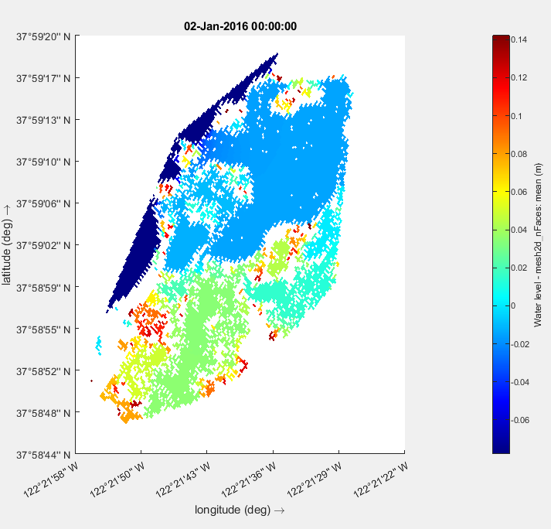
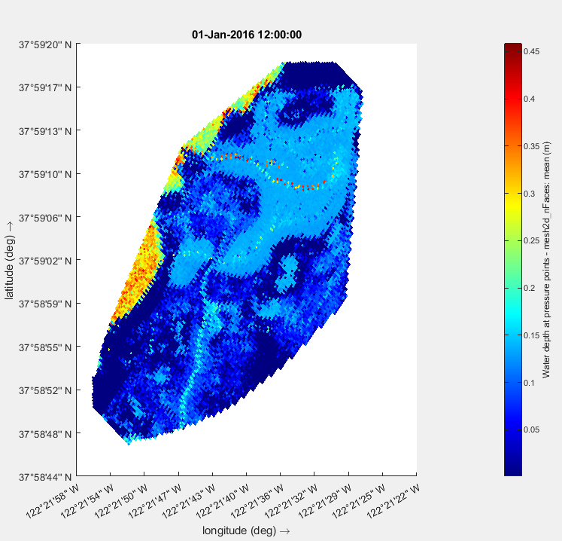
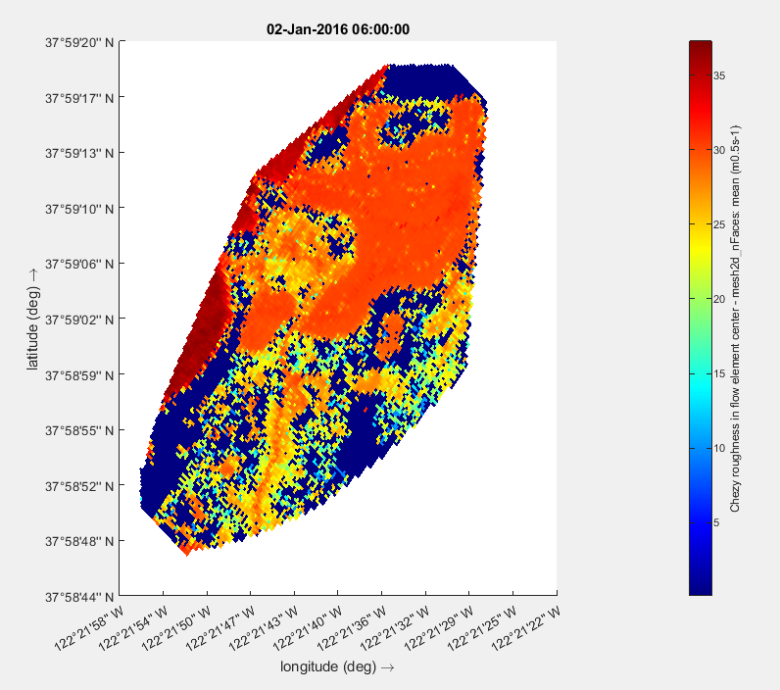
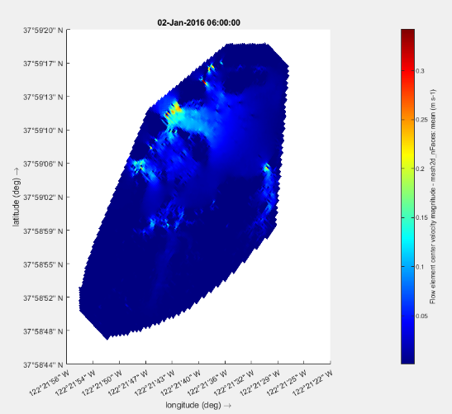
Results to Date
Phase II: Model Calibration and Validation
The team performed initial calibration of the hydrodynamic and wave modules in Delft3D (separately and coupled) to test the accuracy and robustness of the model. We followed calibration methods similar to those defined in Nederhoff et al. (2021).
We used OpenDA, an open interface tool for rapid calibration and data assimilation, to calibrate the Delft3D hydrodynamic and wave models.
We ran several preliminary calibration simulations – interchanging parameter combinations and estimates for each simulation. The goal of this effort was to minimize the difference between observed values and model outputs (RMSE <0.5).
Figure. A subset of preliminary model testing using specified calibration parameters in Delft3D depicting a) cell averaged water level, b) cell averaged water depth, c) Chezy roughness, and d) flow velocity.
Notes:
This section should encompass several slides. The use of graphics/pictures/graphs/tables is strongly encouraged. Ensure font size on graphics/tables/graphs is large enough to be easily read by the audience and includes captions, table headings, axis labels, or legends as applicable.

Slide 14
Results to Date
The team has made significant progress toward full calibration of the hydrodynamic and wave models and will soon be able to calibrate the integrated vegetation components with support from Deltares.
We will compare calibration ‘goodness-of-fit’ across all models (separately and fully integrated). Specifically, we will evaluate 1) overall RMSE and bias, and 2) residual areas with large discrepancies in model output. Our goal is to understand how the fully integrated model will reproduce vegetation extent and sediment accretion for the observed time periods.
With support from local partners, SFEI and EBRPD, the team will compare model output with storm event information and determine the ability for the model detect the presence of hydrologic or morphologic anomalies.
The team is working with Navy subject matter experts to gather data at the second site and determine next steps for calibration using a similar model setup. More information will be shared in the next quarterly progress report.
Notes:
This section should encompass several slides. The use of graphics/pictures/graphs/tables is strongly encouraged. Ensure font size on graphics/tables/graphs is large enough to be easily read by the audience and includes captions, table headings, axis labels, or legends as applicable.

Slide 15
Issues
Due to staff turnover and internal administrative delays, we have not yet been able to calibrate the vegetation components of our coupled model. This includes the accretion and NBSDynamics modules.
We are currently working with Deltares to fully integrate both components into the Delft3D Flow-Wave modeling suite. Calibration will begin once integration is complete.
These delays were not anticipated and have temporarily slowed Phase II progress.
Financial Implications: No current cost overrun is anticipated, but further delay in subcontracting or staffing could require no-cost extension to maintain model fidelity and delivery schedule.
Impacts to Project Timeline: Vegetation model calibration is approximately one quarter behind schedule. However, the team expects to realign with the overall timeline if integration is completed this quarter and calibration begins as planned.
Notes:
Include slide only if required.

Slide 16
Next Steps
 |  | 2024 |  | 2025 |  |  |  | 2026
Phase | Task | Q3 | Q4 | Q1 | Q2 | Q3 | Q4 | Q1 | Q2 | Q3 | Q4
Site Selection and Key Calibration Parameters | 1
 | 2
 | 3
Calibration and Validation | 4
Model Simulation | 5
 | 6
Output Compilation and Analysis | 7
 | 8
Reporting and Technology Transfer | 9
 | 10
 | 11
 | 12
Annual ESTCP IPR | -- |  |  |  | X |  |  |  | X
Symposium Poster Presentation* | -- |  |  |  |  |  | X |  |  |  | X
Quarterly Reports | --
Submit peer-reviewed journal article | -- |  |  |  |  |  |  |  | X
Final Report | -- |  |  |  |  |  |  | X | X
*The team will present a poster during each active year at the SERDP and ESTCP symposium
Major milestones:
General framework recommendations report (12/31/2025)
Submit peer-reviewed journal article (03/31/2026)
Final Report (03/31/2026)

Slide 17
Impact to DoD Mission
Top 3 Accomplishments
Successful integration of Delft3D hydrodynamics and wave models for restored and benchmark marshes, establishing the foundation for evaluating restoration performance.
Development of a coupled modeling framework that links waves, flow, sediment, and vegetation, enabling predictive simulation under future sea level rise and restoration design scenarios.
Selection and characterization of two paired marsh sites (Dotson and Giant Marsh) with extensive data support, strengthening model calibration and real-world applicability.
Notes:
The SERDP ESTCP communications team will review this section for any significant updates that can be shared to demonstrate program successes.

Slide 18
Impact to DoD Mission (continued)
Why This Matters for DoD
Coastal DoD installations face rising threats from sea level rise, storm surge, and coastal erosion.
This project delivers a science-based, predictive design framework for salt marsh restoration, supporting nature-based infrastructure that enhances resilience while lowering lifecycle costs.
It enables DoD planners and engineers to quantify performance tradeoffs and optimize designs for installation protection, ecosystem restoration, and regulatory compliance.
Notes:
The SERDP ESTCP communications team will review this section for any significant updates that can be shared to demonstrate program successes.

Slide 19
Impact to DoD Mission (continued)
Broader Community Impact
Advances a scalable, transferable approach for salt marsh design applicable to East, West, and Gulf Coast installations.
Reinforces collaboration with USGS, SFEI, and Deltares, promoting cross-agency learning and standardization.
Supports broader Engineering With Nature (EWN) goals, building coastal resilience while preserving ecological function.
Notes:
The SERDP ESTCP communications team will review this section for any significant updates that can be shared to demonstrate program successes.

Slide 20
Technology Transfer
Main product: Salt marsh model and initial design framework for nature-based shoreline solutions
DoD Users: DoD installation and USACE planners, regulators, and coastal engineers
Initial Target Group: Coastal engineers/planners on the U.S. East Coast.
Tech Transfer Plan:
Engage primary stakeholders and users early
Tailor outputs for planning and design workflows
Develop user-specific communication strategies
Provide documentation and training support
Notes:
NOTE FOR PROJECT TEAM: Technology Transfer Examples
Training workshops, live or via webinar
Presentations at key conferences
Web-based tools (see example at link)
http://t2.serdp-estcp.org/t2template.html#tool=CSIA&page=Introduction
Guidance documents
Technology fact sheets
“How to” Videos
Community open houses

Slide 21
Project Funding (Submit this table to your Program Office 2 weeks in advance of the IPR)
 | FY23 | FY24 | FY25 | FY26 | Total
Proposal Requested ($K) | 0 | 459 | 245 | 0 | 990
Funds Received | 0 | 459 | 0 | 0 | 448
Funds Expended (Invoiced) | 0 | 142 | 0 | 0 | 423
Requested Revised Funding | 0 | 0 | 245 | 0 | 990
Notes:
NOTE FOR PROJECT TEAMS: Example Data filled in – remove and replace with your actual data.
Adjust fiscal years to reflect all years in which funding was received and is planned.
If substantial funds have not been spent from previous years, please provide a revised funding profile for the current fiscal year and future years. Requested funds for the current and future years should be an amount that you expect can be spent within that calendar year (see example next page). Please contact the Program Office in advance of the IPR if you are unclear on how to restructure the funding profile.

Slide 22
BACKUP MATERIAL
These charts are required, but will only be briefed if questions arise.

Slide 23
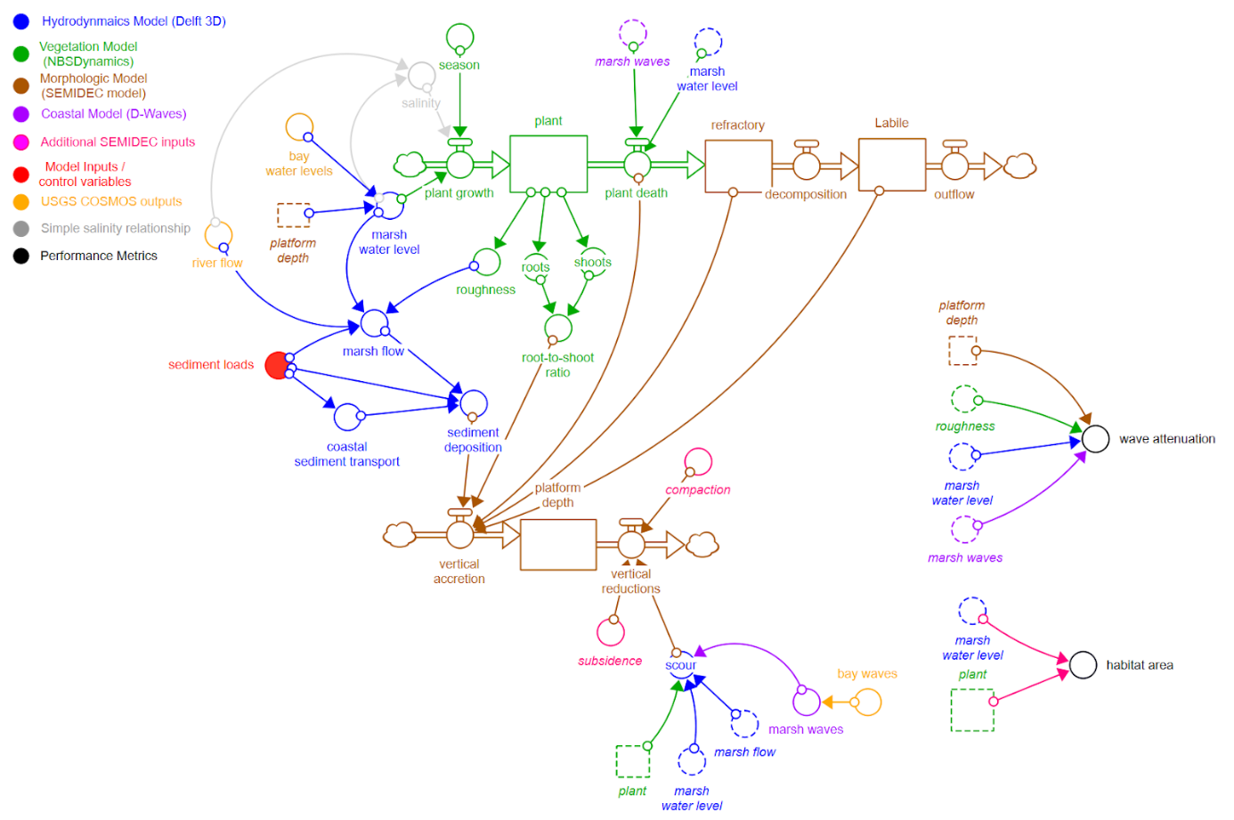
NH24-8072: Advancing Engineering Design Guidance for Constructed Salt Marshes with High Fidelity Modeling and Long-Term Monitoring
Performers:
Todd Steissberg (ERDC-EL, Lead PI), Matt Smith & Marriah Abellera (USACE-IWR), Jenny Olszewski (USGS), with NAVFAC, Deltares, and SFEI collaboration.
Technology Focus
Development of a high-fidelity, spatially distributed salt marsh model integrating hydrodynamics, waves, sediment, and vegetation to inform resilient restoration design
Demonstration Site
Dotson Family Marsh, San Pablo Bay, California (with benchmark site: Giant Marsh)
Demonstration Objectives
Simulate wave attenuation and habitat performance under current and future sea level conditions at restored and reference salt marsh sites. Develop initial engineering design framework for salt marshes
Project Progress and Results
Phase I complete: site selection, data collection, initial model development. Phase II underway: hydrodynamic and wave models calibrated; vegetation and sediment model integration in progress. Delays due to staffing and admin issues; calibration pending.
Implementation Status
Coordination ongoing with NAVFAC, SFEI, and Deltares
Next steps: full model integration, calibration, and evaluation under future scenarios.

Slide 24
Plain Language Summary
Problem: Many DoD coastal installations face increasing flood risks and shoreline loss, but current design tools lack the ability to simulate how restored salt marshes perform under future sea level rise and storm conditions.
Objective: We’re building a high-resolution model that links water flow, waves, sediment, and plant growth to test how different salt marsh designs reduce flooding and improve habitat over time.
Approach: The model is calibrated using real-world data from two marshes in San Francisco Bay—one restored, one natural—to simulate performance under historic and future conditions.
Outcomes: The results will help DoD planners and engineers design more resilient nature-based shorelines, with science-based tools for evaluating and optimizing marsh restoration strategies.
Notes:
REFERENCE FOR PROJECT TEAMS: Provide a summary of the problem, the proposed solution and how it addresses or solves the problem. The purpose of this slide is to provide the technical committee (TC) an updated “pitch” on why this project was funded. Some questions to answer:
What technology or methodology is being evaluated during this demonstration?
What is the baseline at most DoD installations for the demonstrated technology? (nationally?)
What is the “state of the art” today?
How will the project advance the state of the art?

Slide 25
Action Items
None
NOTE: Include only if required.
Notes:
Please include in main presentation, prior to backup, if an action item is applicable to this meeting.

Slide 26
Status of Funds for Federal Performers
Report on the status of funds for each MIPR received by a directly funded Federal performer. Provide information on each fiscal year for which there has not been 100% expenditure of funds. If you or your co-performer do not understand how to fill this out, contact your Program Manager in advance of the IPR.
FY2025 Funds
Directly Funded Federal Performer(s) | Funds Received | Funds Obligated* | Percent Funding Obligated
USACE - Direct Cite MIPR | 264 | 157 | 59%
Federal Performer A - Reimbursable MIPR | 180 | 0 | 0%
Federal Performer B - Direct Cite MIPR | 15 | 1 | 7%
Federal Performer B - Reimbursable MIPR
* Funds put on contracts and/or purchase orders that have been issued, and funds associated with internal labor or travel expenses that have been incurred.
Notes:
NOTE FOR PROJECT TEAM: Report on the status of funds for each MIPR received by a directly funded Federal performer. Provide information on each fiscal year for which there has not been 100% expenditure of funds. If you or your co-performer do not understand how to fill this out, contact your Program Manger in advance of the IPR.

Slide 27
Publications
Smith, M., M. Abellera, J. Olszewski, T. Steissberg, in prep. “Evaluating hydrodynamic and biophysical feedbacks leading to steady state conditions in a coastal salt marsh of San Francisco, CA”

Slide 28
Literature Cited
Brand, M. W., Buffington, K., Rogers, J. B., Thorne, K., Stein, E. D., & Sanders, B. F. (2022). Multi‐decadal simulation of marsh topography under sea level rise and episodic sediment loads. Journal of Geophysical Research: Earth Surface, 127(9), e2021JF006526.
Buffington, K. J., Dugger, B. D., Thorne, K. M., & Takekawa, J. Y. (2016). Statistical correction of lidar-derived digital elevation models with multispectral airborne imagery in tidal marshes. Remote Sensing of Environment, 186, 616-625.
Foster-Martinez, M. R., Lacy, J. R., Ferner, M. C., & Variano, E. A. (2018). Wave attenuation across a tidal marsh in San Francisco Bay. Coastal Engineering, 136, 26-40.
Nederhoff, K., Saleh, R., Tehranirad, B., Herdman, L., Erikson, L., Barnard, P. L., & Van der Wegen, M. (2021). Drivers of extreme water levels in a large, urban, high-energy coastal estuary–A case study of the San Francisco Bay. Coastal Engineering, 170, 103984
Thorne, K. M., Elliott-Fisk, D. L., Wylie, G. D., Perry, W. M., & Takekawa, J. Y. (2014). Importance of biogeomorphic and spatial properties in assessing a tidal salt marsh vulnerability to sea-level rise. Estuaries and Coasts, 37, 941-951.
Willemsen, P. W. J. M., Smits, B. P., Borsje, B. W., Herman, P. M. J., Dijkstra, J. T., Bouma, T. J., & Hulscher, S. J. M. H. (2022). Modeling decadal salt marsh development: variability of the salt marsh edge under influence of waves and sediment availability. Water Resources Research, 58(1), e2020WR028962.

Slide 29
Technical Risks
ASSUMPTIONS
Appropriate sites and data are available
Significant relationships exist between marsh characteristics and performance objectives
Relationships identified in San Francisco Bay will be transferable to other parts of the US.
RISK MANAGEMENT PLAN
Careful site and data review / selection
Careful scenario selection
SCALE-UP STRATEGY
In order to scale this technology to all relevant coastal DoD installations, additional pilots would be required in future years across the main coastal US regions.

Slide 30
Additional Slide(s) for High-Quality Photos

Slide 31
Acronym List
Delft3D-FM: Delft 3-Dimensional Flexible Mesh
NBSDynamics: Nature Based Solutions Dynamics
RMSE: Root Mean Square Error
SEMIDEC: SEdimentation, MIneralization, and DEComposition model

